Slide 1
Employee Data Analysis using Excel
STUDENT NAME: Usharani.D
REGISTER NO: 312209872
NMID: 451033EBF88751E807345C180E388C5D
DEPARTMENT: B.COM (accounting and finance)
COLLEGE: valliammal college for women

Slide 2
PROJECT TITLE
Employment Data Analytics Using Excel Techniques
+

Slide 3


AGENDA
Problem Statement
Project Overview
End Users
Our Solution and Proposition
Dataset Description
Modelling Approach
Results and Discussion
Conclusion
3/21/2024 Annual Review

Slide 4

PROBLEM STATEMENT
Analyzing Employment data is essential for various reasons across different sectors, including economics, business, and public policy. Some key reasons are;
Economic Health Indicator
Policy Formulation
Business Planning
Wages and Income Analysis
Forecasting

Slide 5

PROJECT OVERVIEW
This project aims to analyze employment data to uncover labor market trends, assess economic health, and provide actionable insights for decision-making. By focusing on key metrics such as employment rates, wages level, and sector-specific trends over the past five years, the analysis will help identify areas for policy intervention and strategic planning.

Slide 6
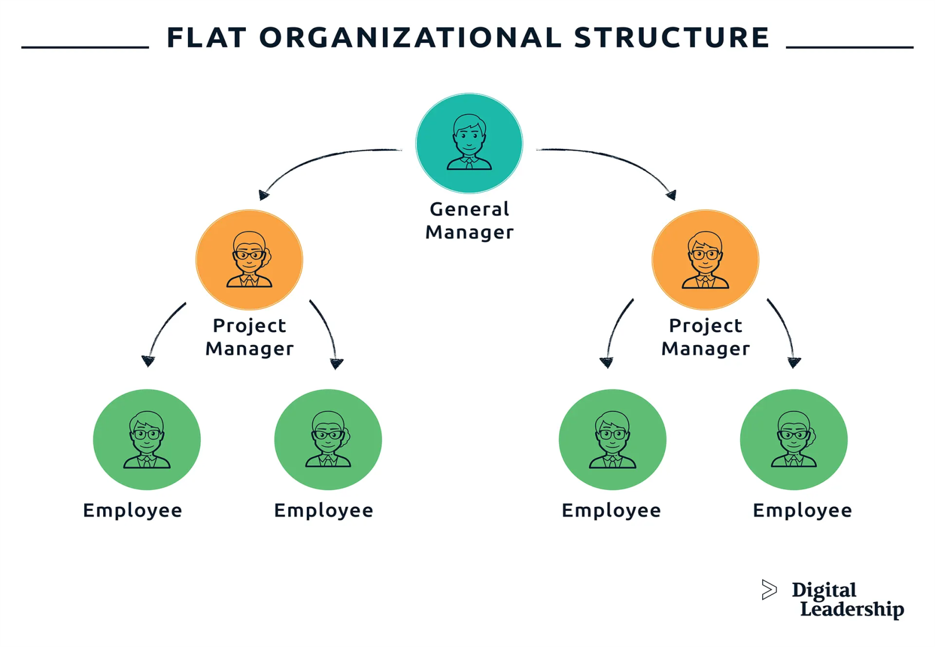

WHO ARE THE END USERS?

Slide 7

OUR SOLUTION AND ITS VALUE PROPOSITION
CONDITIONAL FORMATTING:
It is used to identify the missing elements
FILTERING:
It is used to remove the unwanted elements
FORMULA:
It is used to analyze the performance level
4) GRAPH:
It is used to represent the data visualization

Slide 8
Dataset Description
This description is about employee data analysis which is done through kaggle. It has 26 total features and in this data set it has involved 6 feature which includes;
Employee ID
Name
Gender
Department
Salary
Employee Type.

Slide 9

THE "WOW" IN OUR SOLUTION
PERFORMANCE LEVEL= IFS(Z8>=5, “VERY HIGH”, Z8>=4, “HIGH”,Z8>=3,”MED”,TRUE,” LOW”)
3/21/2024 Annual Review
9

Slide 10
MODELLING
DATA COLLECTION:
Collection of employees Id
Collection of employees Bio reference
DATA CLEANING:
Removing duplicates
Handling missing data
Correcting errors
PERFORMANCE LEVEL:
Used formulas to identify ratings
10

Slide 11
RESULTS
11

Slide 12
conclusion
In summary, the analysis of the employee dataset provides key insights into work composition and performance. While these findings are informative, further analysis with more comprehensive data may be needed to refine these insights. Overall, the results from this dataset can guide future decisions in recruitment, training, and employee retention strategies.

